Slide 1
Home security using IoT
SUBMITTED BY,
JOYAL RAJU
C0749019

Slide 2
CONTENTS
What is the system?
Who all are the end users?
Drawbacks of the system
Possible modifications
Conclusion
Reference

Slide 3
What is the system?
One of the major concern nowadays is security.
Some areas are reserved for authorized personnel.
Unauthorized access to these areas can be identified.
User or authorized person will get the notification.
Buzzer system can be controlled remotely.

Slide 4
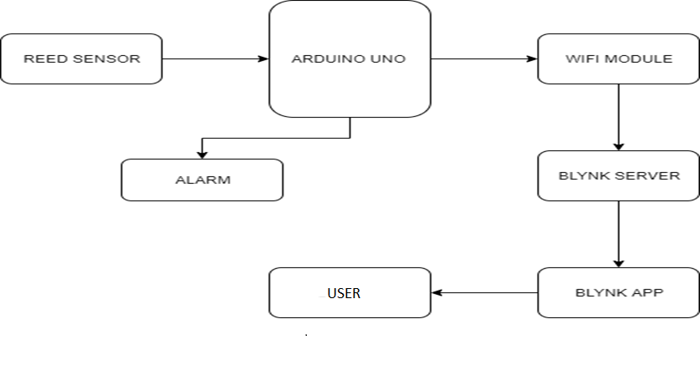
BLOCK DIAGRAM

Slide 5
Who all are the end users?
House owner
Warehouse manager
Bank manager
Restaurant manager
Industrial officials
End user can be varied according to the application

Slide 6
Drawbacks of the system
Surveillance system is not present to identify the intruder.
Automatic lock down is required to prevent unauthorized access attempt.

Slide 7
Possible modifications
WIFI cameras can be added inside these restricted areas to identify the intruder and upload to the server.
To reduce power consumption of the camera, a control unit can be added to the existing system.
By including a pin pad at the door can improve the security of the system
User can pre-lock the system from his phone using pin pad technique.

Slide 8
Conclusion
As the system is easily upgradable, suggested modifications can be incorporated with the existing system at a reasonable rate.
Security of the new system will be much better than old one as it consist of pin pad as well.

Slide 9
reference
Home security system using internet of things (2017)
https://iopscience.iop.org/article/10.1088/1757-899X/263/4/042026
https://www.vivint.com/resources/article/how-do-wireless-security-cameras-work

